Slide 1

WELCOME
SYLVAN HILLS MIDDLE
GO TEAM MEETING

Slide 2
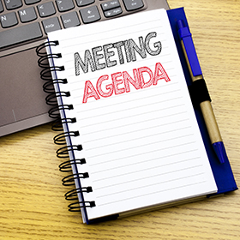
Today’s Agenda
Call to Order
Review GO Team Norms
Roll Call; establish quorum
Action Items
  Approval of Agenda
  Review of Previous Meeting Minutes
Information Items
  Principal’s Report
  FY22 Budget Development Presentation
Announcements
Public Comment
Q & A
Adjournment

Slide 3

Let’s commit to:
Wearing masks and socially distancing
Being present and engaging meaningfully so that we can learn from each other (i.e. Cameras on)
Refrain from using electronic devices unless required to engage in the work
Muting your microphone (VIRTUAL) and minimizing extraneous conversations
Assuming good will
Allowing all voices of the team to be heard
Focusing on the day’s content
Starting and ending on time
Being gracious

Slide 4
GO TEAM MEMBERS 20-21
NAME | ROLE
Ms. Monica Blasingame | Principal
Ms. Jessica Bracey | Parent
Ms. Queen Rosa Harden-Green | Parent
Mr. Mark Gresham | Parent
Ms. Sade Miller | Staff
Mr. Derwin Purnell | Staff
Ms. Sonjyia Bryant | Staff
Ms. Keisha Mackey | Community Member
LaSandra Brown | Community Member
Ms. Johna Rhooms | Swing Seat

Slide 5

Action Items
.
Action Items
  Approval of Agenda
  Approval of Previous Minutes

Slide 6



Slide 7

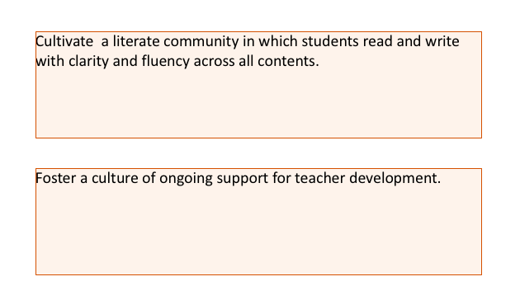
SCHOOL PRIORITIES
2020-2021
SCHOOL PRIORITIES

Slide 8

SY22 Budget….

Slide 9

SHMS SY22 BUDGET.…
What does that mean?
Projected Enrollment | 513 students
Allocation | $6,204,756
Change in Enrollment | -12
Signature Program | $160,500
Turnaround | $0
Title I | $322,920
Family Engagement | $11,000
Title School Improvement | $0
Total FTE Allotments | $1,663,800
Unallocated Funds | $155,645

Slide 10
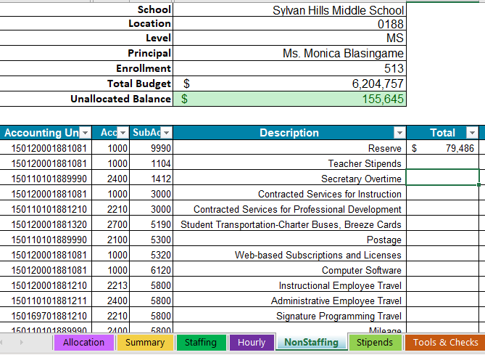
Budget by Function – Non-staffing
Notes:
I am passing out the definitions for these funding categories. You will see what makes up each category. Although the total amount will not change, allocation per function may depending on our conversations and school needs.

Slide 11
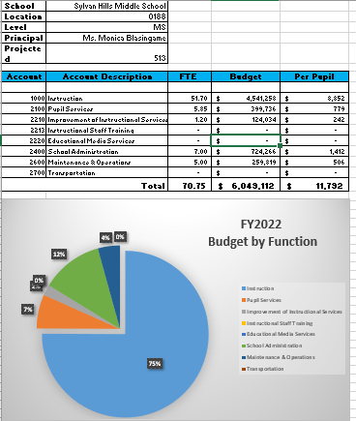
Budget by Function – Allotments
Notes:
Explain the pie chart and allocations

Slide 12
Budget by Function – Non-staffing

Slide 13
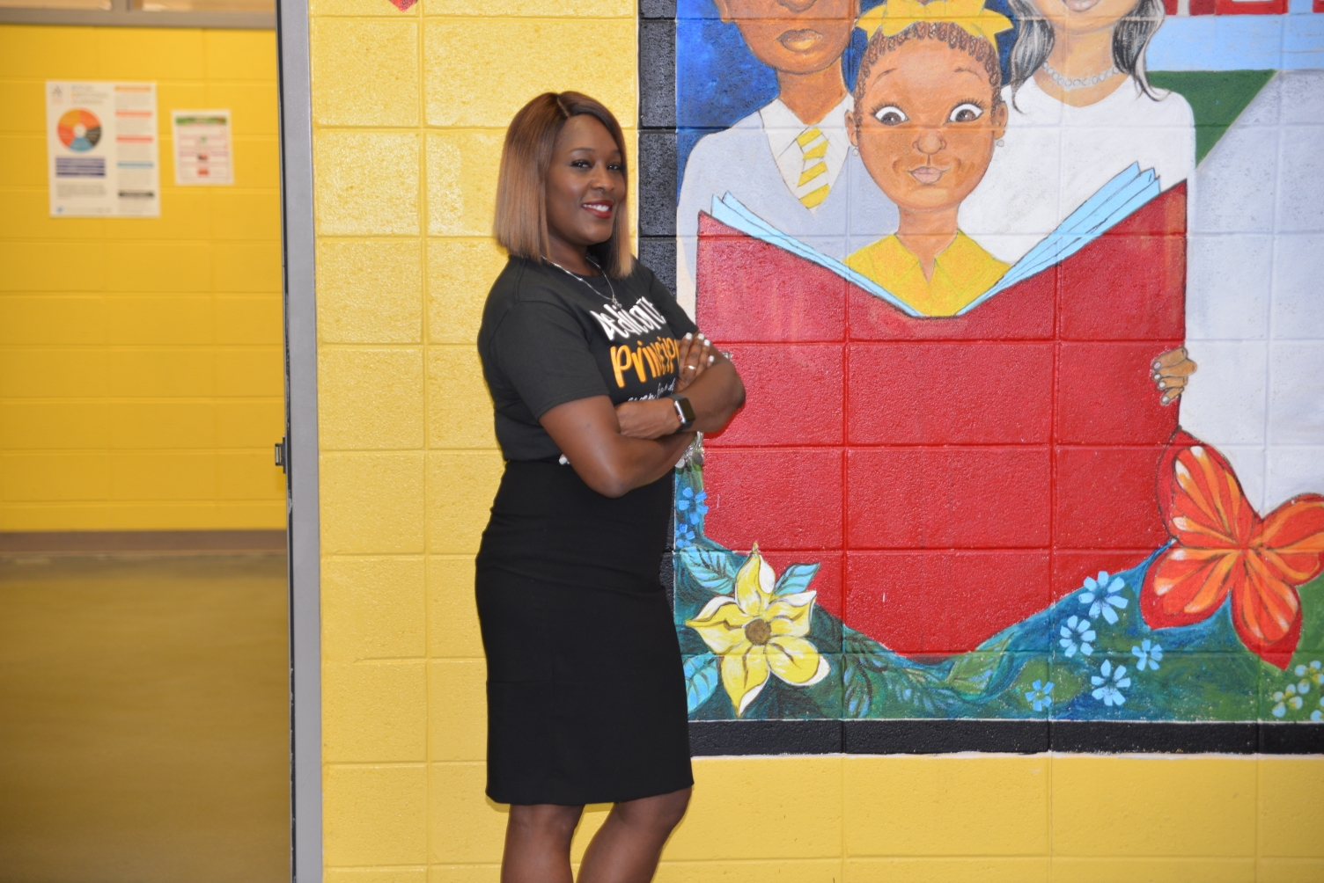
PRINCIPAL’S REPORT
Return to Learn: Phase 2 Updates
This week we celebrate…
National School Counselors Week

Slide 14



Middle School Reopening Plan Student Schedule
Beginning February 16th
Grades 6 – 8 In- Person option begins February 16th
All virtual and in-person students will follow the traditional school hours of 9:05 AM – 4:05 PM
Traditional school hours begin February 16th*
[M/T/Th/F]
Middle
9:05 a.m.- 4:05 p.m.

Slide 15

Structure of School Day
Effective February 16th, all (in-person and virtual) students will return to a traditional full day schedule of 9:00 am - 4:05 pm.
Each grade level will follow a consistent schedule with core instruction, connections, and breaks embedded throughout the day.
Students remaining virtual will mirror the daily schedule that Sylvan students follow during in-person instruction while taking into consideration the best practices of virtual learning.
An additional change has been made to homeroom; 1st period will now become the homeroom class in order to minimize transition.

Slide 16

Instructional Model
In-person class sizes will range from no more than 9-13 students per class based on the square footage of the classroom while accounting for appropriate social distancing.
All students will be strategically scheduled in learning cohorts of no more than 9 students socially distant to support heightened safety precautions.

Slide 17

Maintaining a Healthy Environment
High touch common areas will be wiped down and disinfected twice daily.
Deep cleaning of facilities will occur when students and staff are not present in buildings (Wednesday & Friday).
Teachers will schedule time at the end of the instructional period for routine cleaning and disinfection prior to class change.
Sharing of students’ materials and supplies will be prohibited whenever possible.
Students will minimize the amount of items brought to school each day.
Equipment and supplies that must be shared will be disinfected between uses.
Signage in common areas such as classrooms, hallways and entrances promoting good hygiene measures are posted throughout the campus as a reminder.
Students’ personal belongings will remain with them at their assigned desks and contained within their backpacks. Coats will be placed on the back of the students’ desks.
Student devices must be brought to and from school daily.

Slide 18


What are the expectations for students who are returning in-person?
Water fountains have been disabled. Students must bring their own water bottle from home, filled before school each day, and marked with their name. A bottle-filling station is available.
Each day, students must bring:
Facial Mask
Student Device (Chromebook/laptop)
Headphones (available upon request)
Water bottle

Slide 19

Are students required to wear uniforms?
Grade Level | Shirts (Collared) | Pants / Bottoms | Belts
6th Grade | Yellow Only | Khaki/Black/Navy Blue | Black / Brown
7th Grade | White Only | Khaki/Black/Navy Blue | Black / Brown
8th Grade | Black/Yellow/White | Khaki/Black/Navy Blue | Black / Brown

Slide 20

4th Quarter Intent-to-Return
Families must declare their student’s Intent-to-Return to APS schools beginning February 15 and before March 1, 2021 for the 4th Quarter.

Slide 21
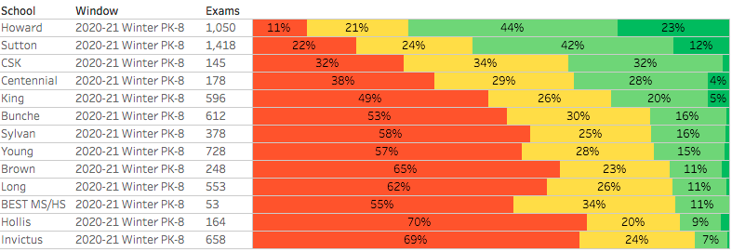
STAR READING

Slide 22
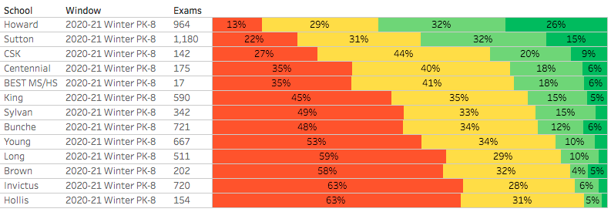
STAR MATH

Slide 23
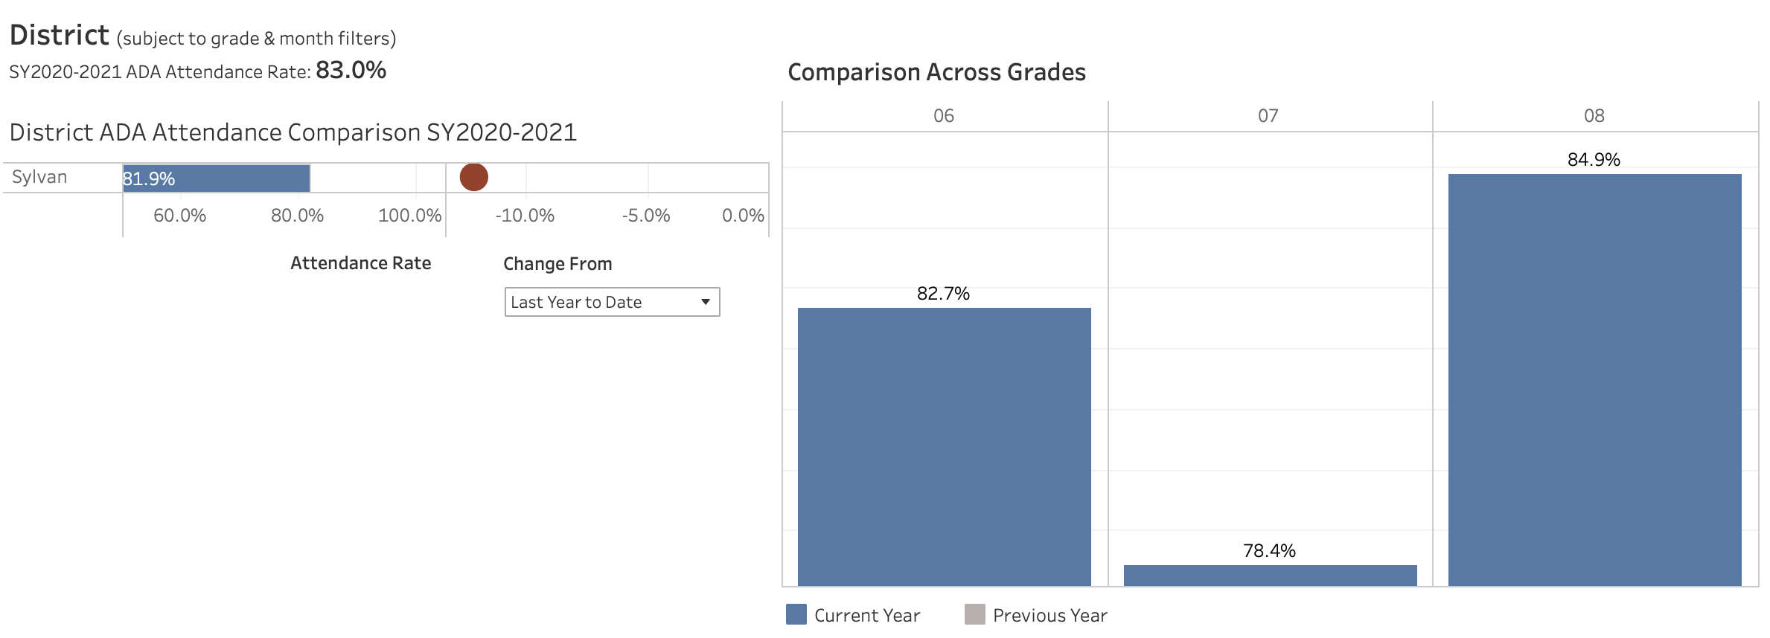
Student Attendance: Year to Date
SHMS

Slide 24
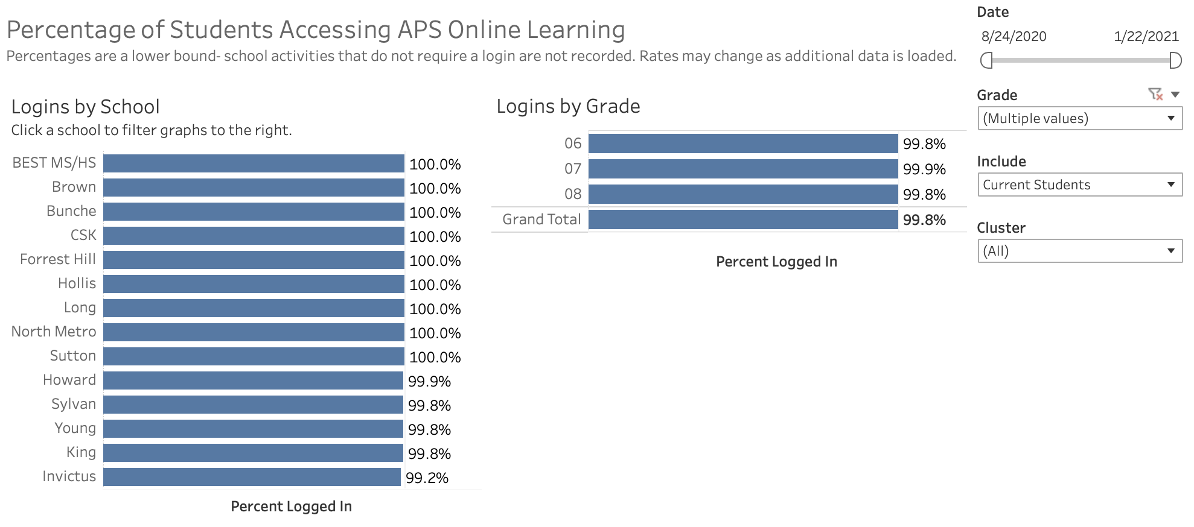
Sylvan Hills Middle School
STUDENT
ENGAGEMENT

Slide 25

Announcements
Public Comment
Adjournment

Slide 26
Public Comment Format
Sylvan Hills Middle School's GO Team welcomes input from students, staff, parents and community members during designated meetings. This includes an opportunity for public comment at the end of the meeting not to exceed 20 minutes. To register for an opportunity to speak, please adhere to the following:
1. Register at the sign-up table (google form will be available for virtual meetings) no later than 30 minutes prior to the Go Team meeting dates.
2. Please include your name, email address, and topic.
3. Community members signing up to speak will be given two (2) minutes.
4. The Go Team cannot take public comment on personnel issues.

